Slide 1
Bitcoin Price Prediction using Regression Models
Group: Sai Sandeep Mandava, Shravan Appala, Rashmi Goli

Slide 2
Abstract
Data Exploration: Import and initial assessment of Bitcoin price data using Pandas to understand the dataset's structure and key statistics.
Feature Engineering: Enhanced data with crucial financial indicators such as moving averages, Bollinger Bands, and Ichimoku Cloud for in-depth analysis.
Visualization for Insights: Employed Matplotlib and Seaborn to visualize trends and patterns, aiding in the interpretation and subsequent analysis of Bitcoin's market behavior.

Slide 3
Introduction
Overview of Bitcoin (BTC-USD):
The dataset represents the historical price data of Bitcoin in USD.
Bitcoin, as the first decentralized cryptocurrency, has significant impact and relevance in the financial and technology sectors.
Timeframe and Data Points:
Covers data from September 17, 2014, to December 6, 2023.
Includes daily price information: Open, High, Low, Close, Adjusted Close, and Trading Volume.
Relevance of the Dataset:
Economic Indicator: Reflects the trends and shifts in the cryptocurrency market.
Investment Analysis: Crucial for investors and financial analysts for making informed decisions.
Technological Impact: Represents the growing influence of blockchain technology in finance.
Historical Insight: Provides insights into the volatility and growth patterns of Bitcoin over nearly a decade.

Slide 4
Data Preprocessing Overview for Bitcoin Price Analysis
Data Import and Initial Assessment
Utilized Pandas to import Bitcoin data from "BTC-USD.csv".
Employed methods like .head(), .info(), and .describe() for initial data exploration, understanding structure and statistical summaries.
Feature Engineering and Data Transformation
Converted 'Date' column to datetime format for accurate time-series analysis.
Added key features for in-depth analysis:
Price Range (High - Low)
Monthly and Yearly Aggregations
30-Day and 90-Day Moving Averages
Daily Price Change
Advanced indicators like EMA, Bollinger Bands, MACD, Ichimoku Cloud, and Stochastic Oscillator.
Visualization and Insight Generation
Prepared data for visualization using Matplotlib and Seaborn.
Created various plots (line charts, histograms, box plots) to uncover trends, distributions, and market dynamics.
These visual insights assist in identifying patterns and guiding subsequent analytical or predictive modeling steps.

Slide 5
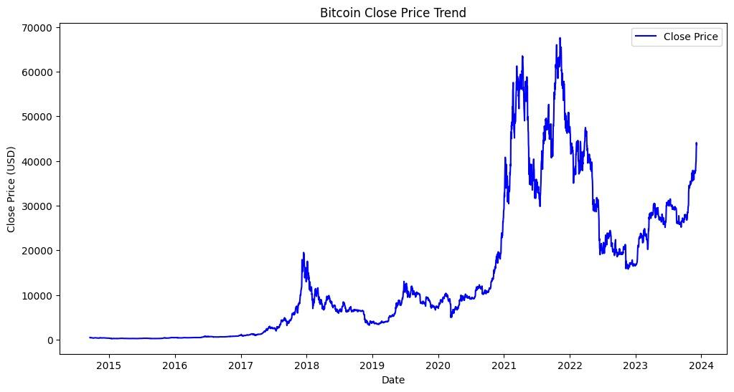
Trend Analysis

Slide 6
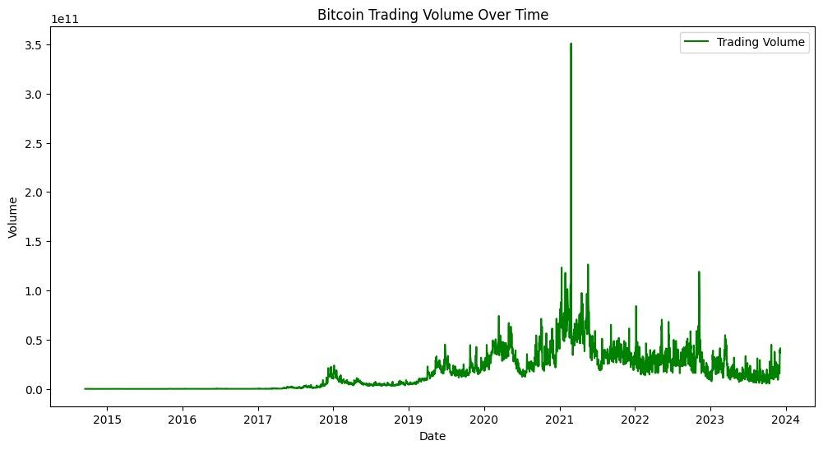
Volume Analysis

Slide 7
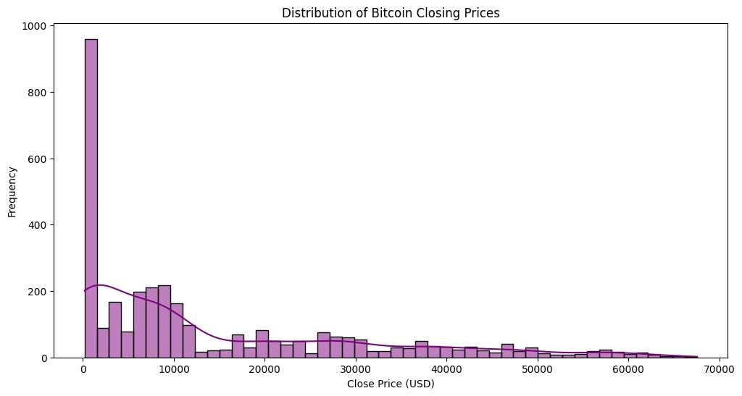
Price Distribution

Slide 8
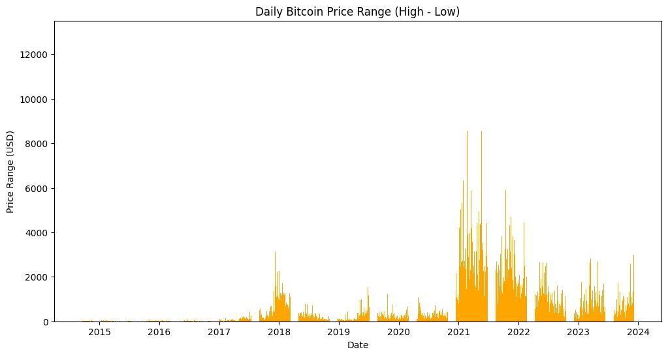
Volatility Analysis

Slide 9
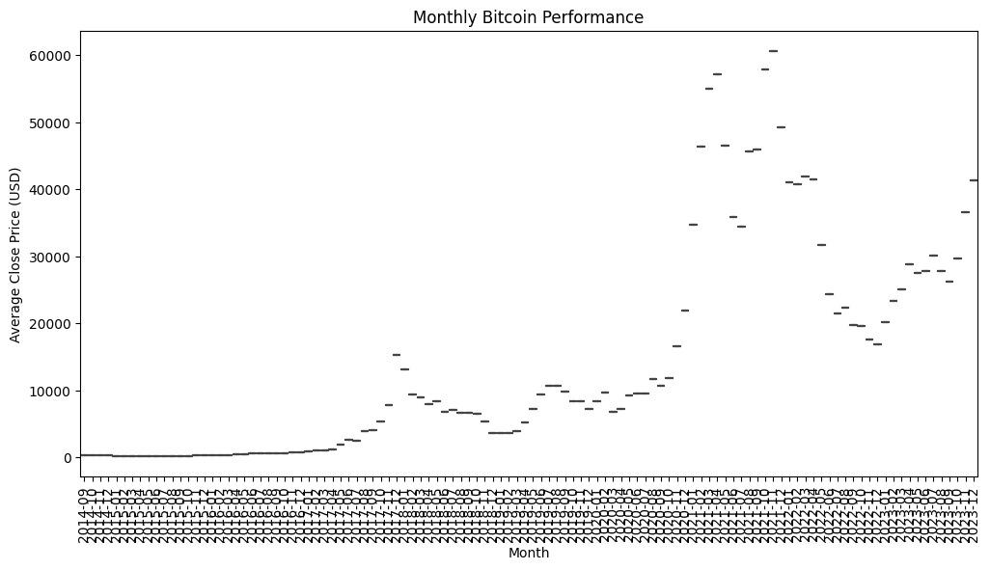
Monthly Performance

Slide 10
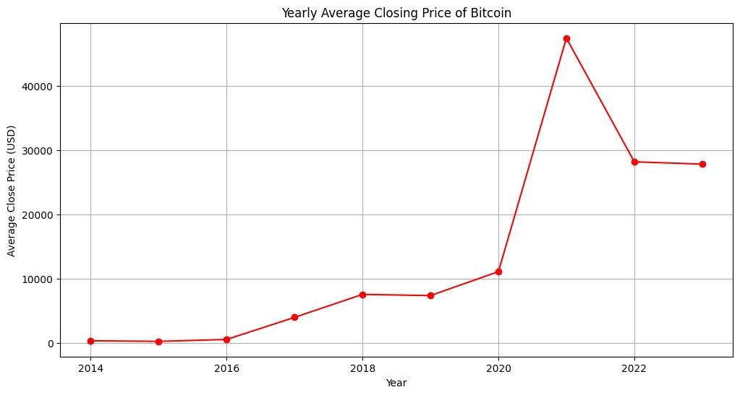
Yearly Performance Comparison

Slide 11
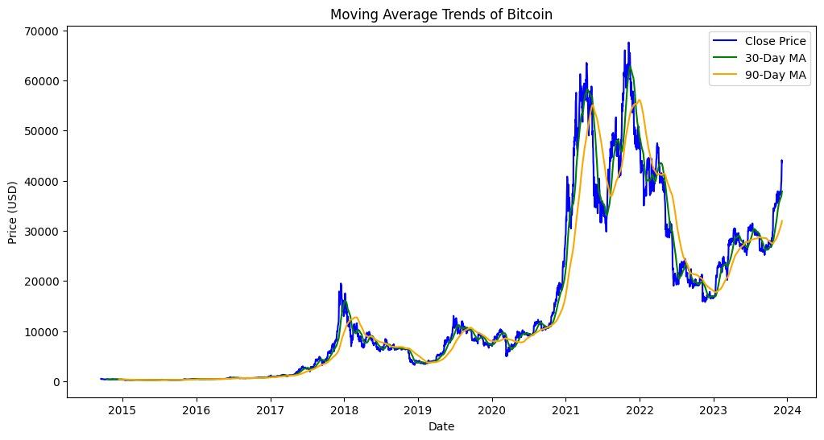
Moving Average Trends

Slide 12
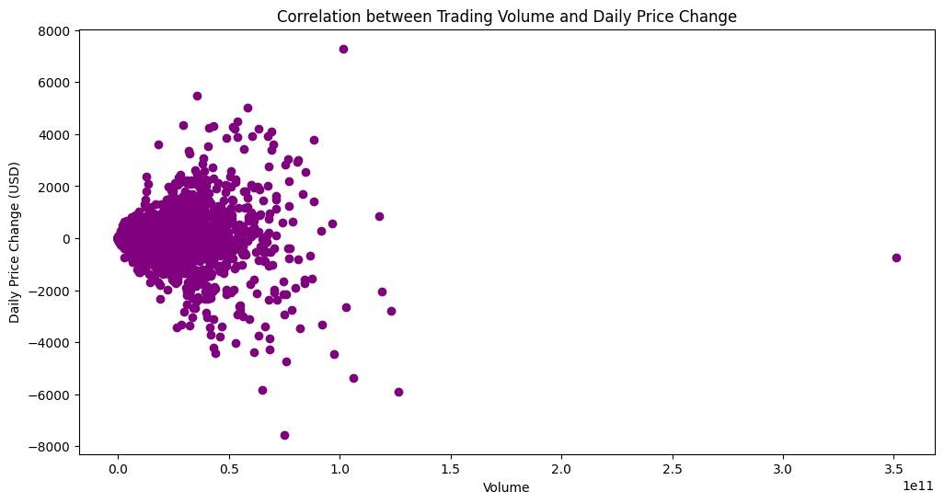
Volume-Price Correlation

Slide 13
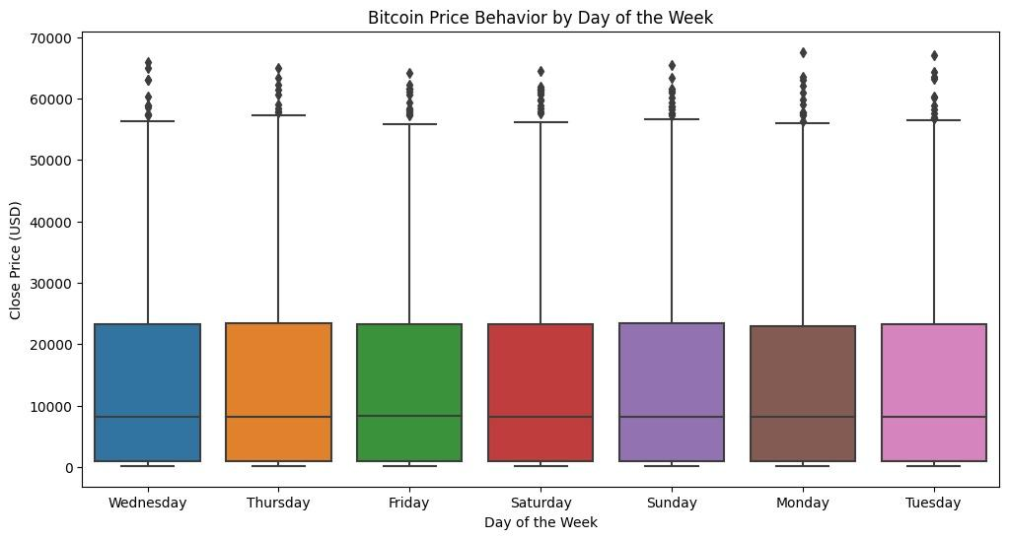
Day of Week Analysis

Slide 14
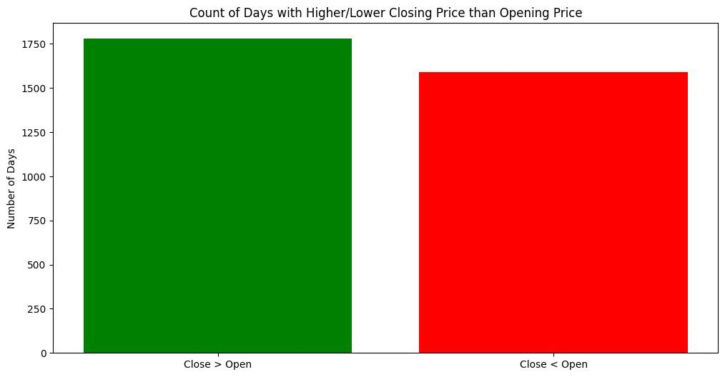
Opening vs. Closing Price

Slide 15
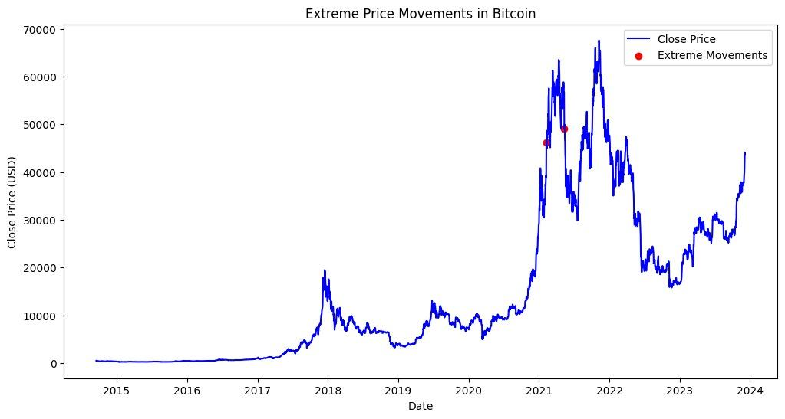
Extreme Price Movements

Slide 16
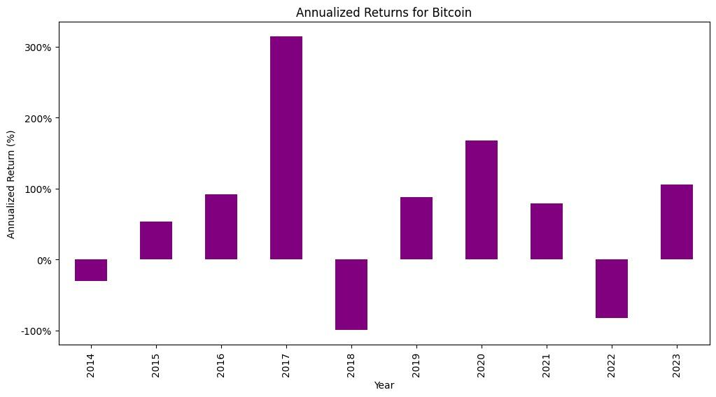
Annualized Returns

Slide 17
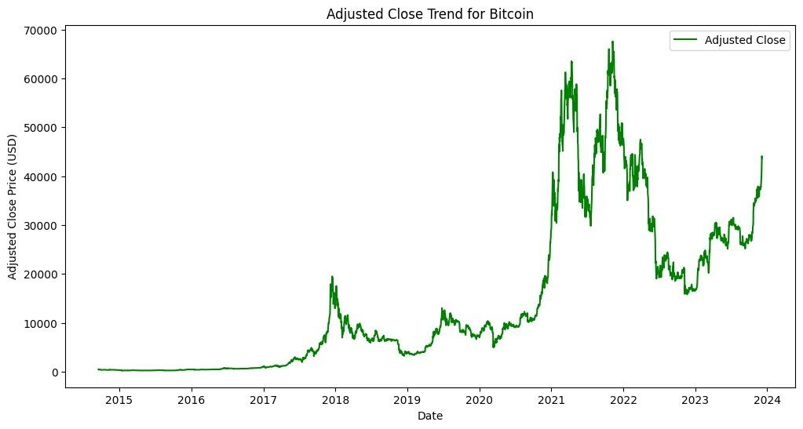
Adjusted Close Trend

Slide 18
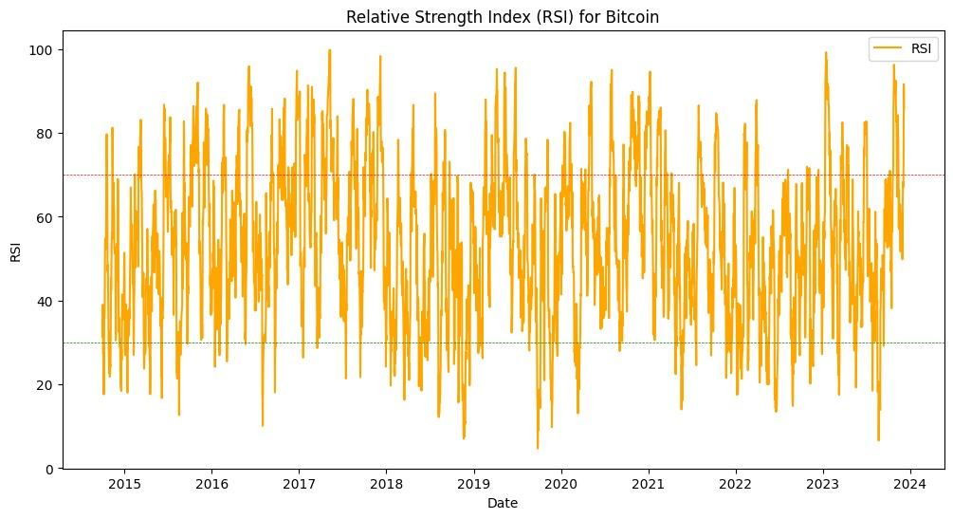
Relative Strength Index (RSI)

Slide 19
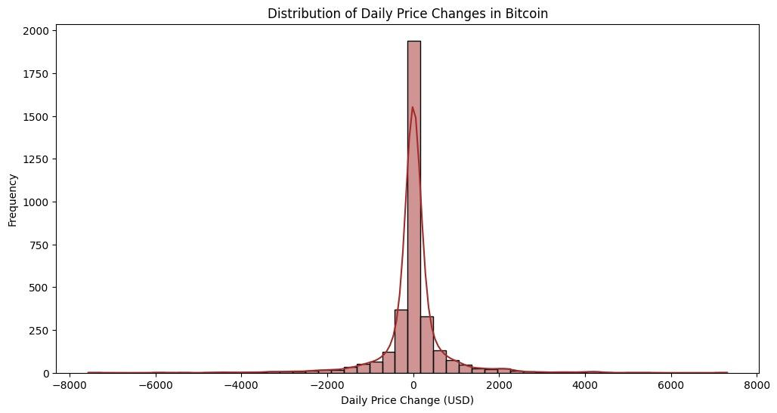
Price Change Distribution

Slide 20
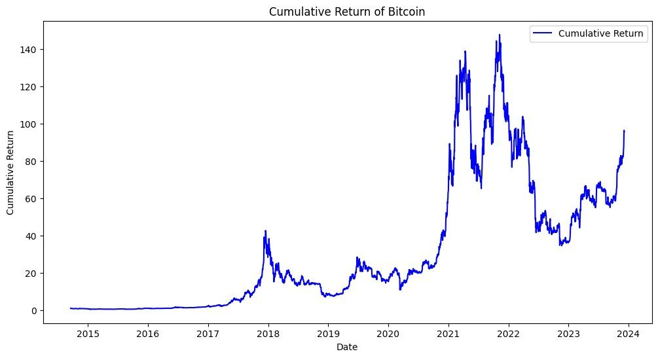
Cumulative Returns

Slide 21
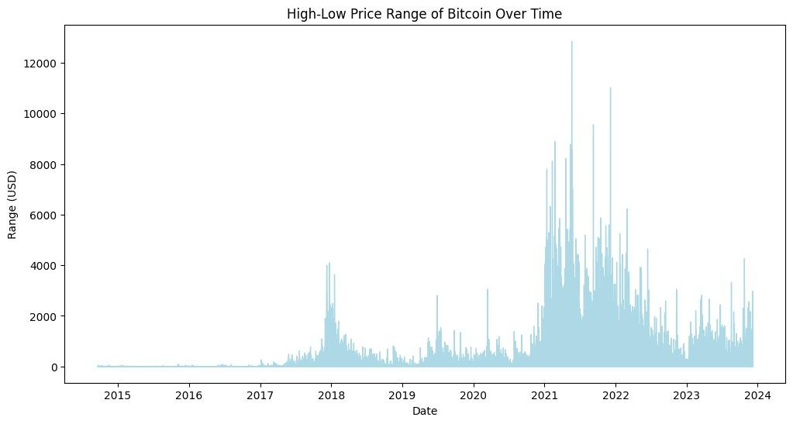
High-Low Range Over Time

Slide 22
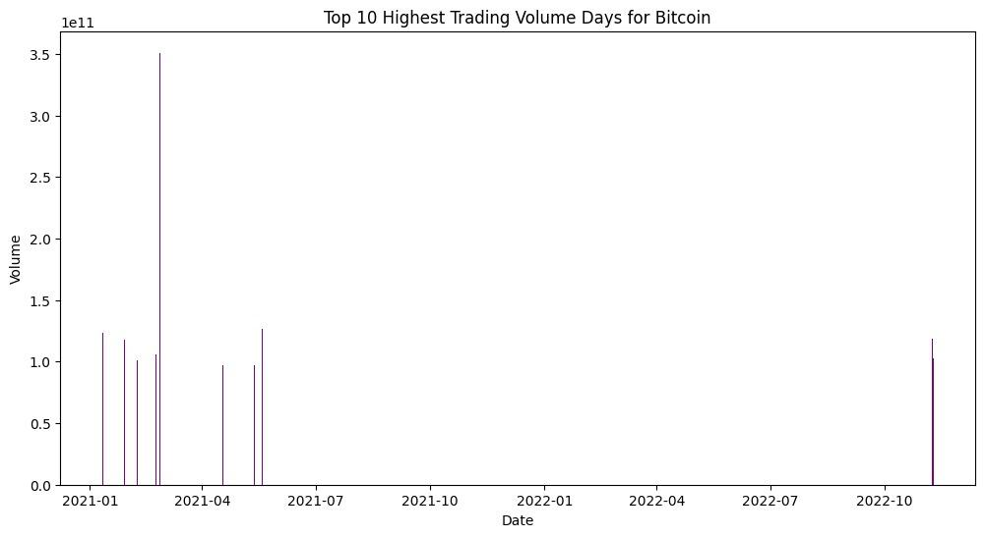
Volume Peaks

Slide 23
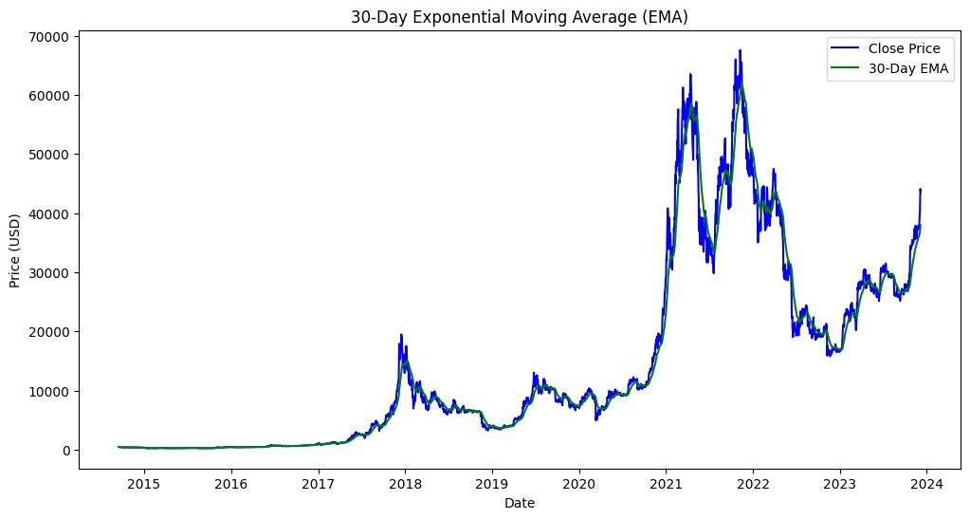
30 Days Exponential Moving Average

Slide 24
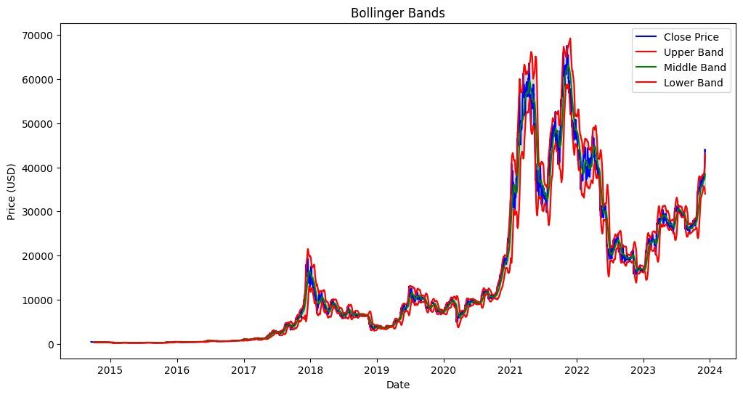
Bollinger Bands Indicator

Slide 25
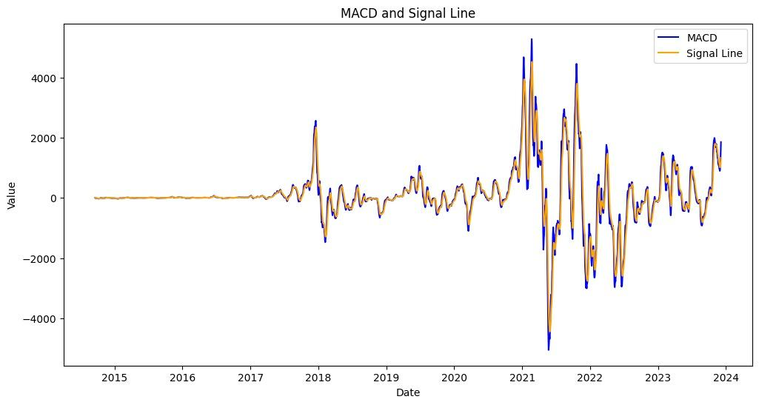
MACD Indicator

Slide 26
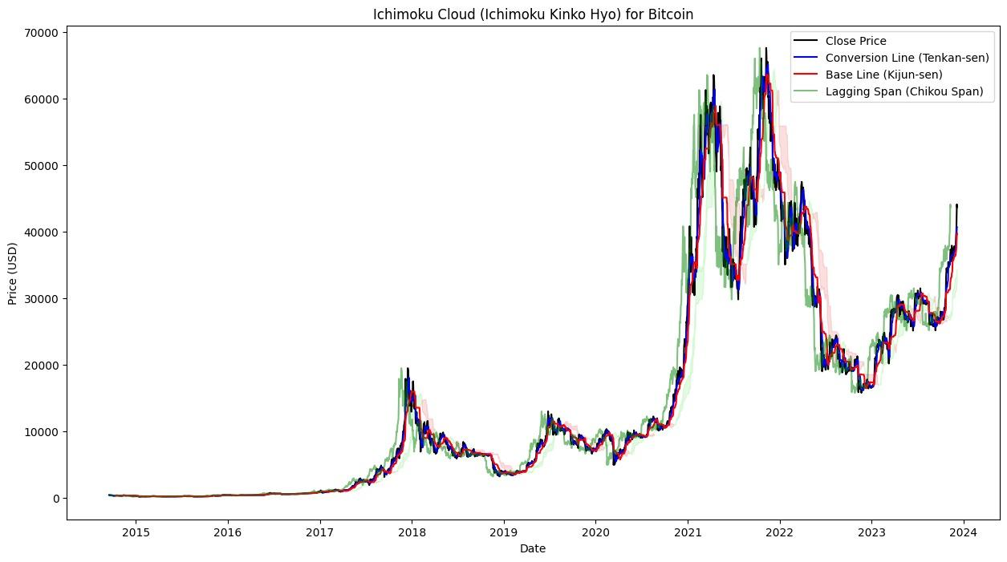
Ichimoku cloud

Slide 27
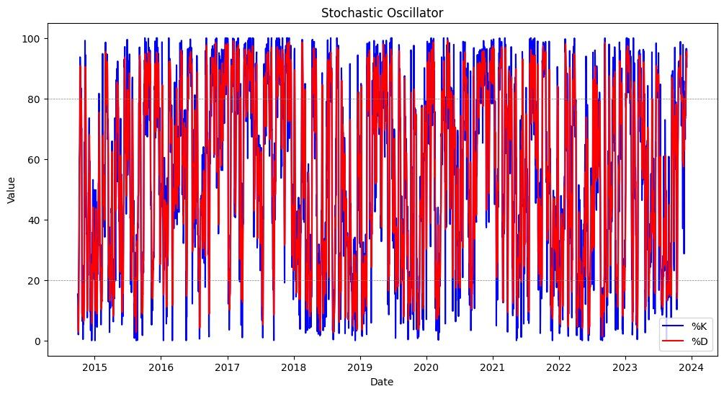
Stochastic Oscillator

Slide 28
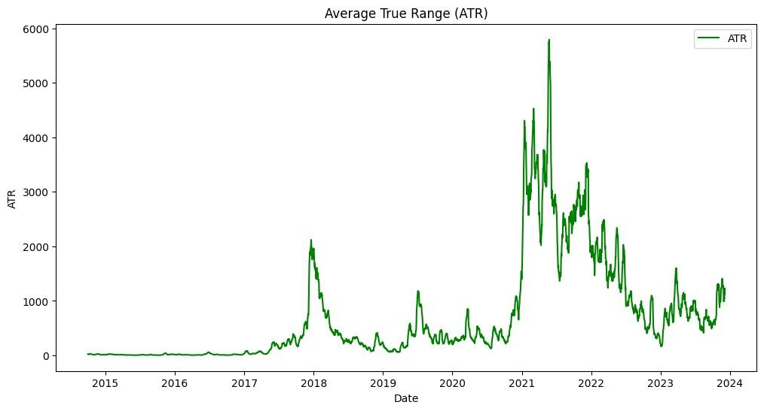
Average True Range

Slide 29
Comparison of Regression Models
Linear Regression:
Mean Squared Error (MSE): 102,832.22
R-squared Value (R²): 0.9996
Decision Tree Regressor:
Mean Squared Error (MSE): 280,772.64
R-squared Value (R²): 0.9989
Random Forest Regressor:
Mean Squared Error (MSE): 178,947.49
R-squared Value (R²): 0.9993

Slide 30
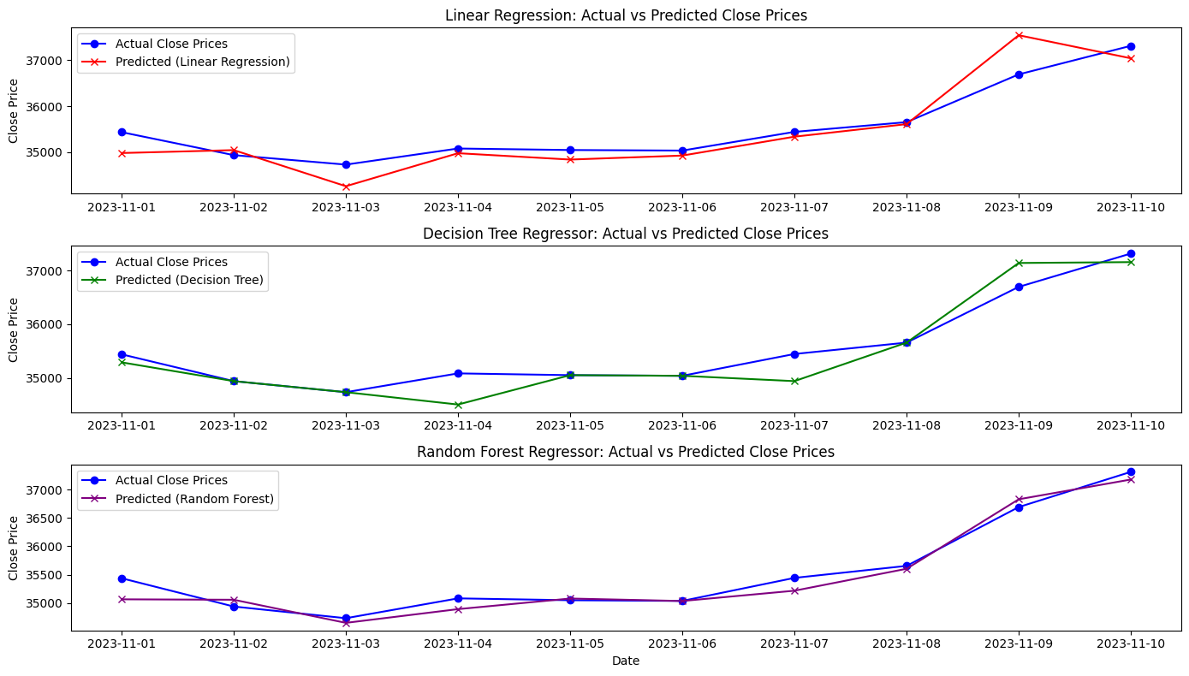
Predicting Last days

Slide 31
Comparison of Regression Models Using Moving Average
Linear Regression using Moving Average:
Mean Squared Error (MSE): 103,963.95
R-squared Value (R²): 0.9996
Decision Tree Regressor using Moving Average:
Mean Squared Error (MSE): 289,601.14
R-squared Value (R²): 0.9989
Random Forest Regressor using Moving Average:
Mean Squared Error (MSE): 183,417.75
R-squared Value (R²): 0.9993

Slide 32
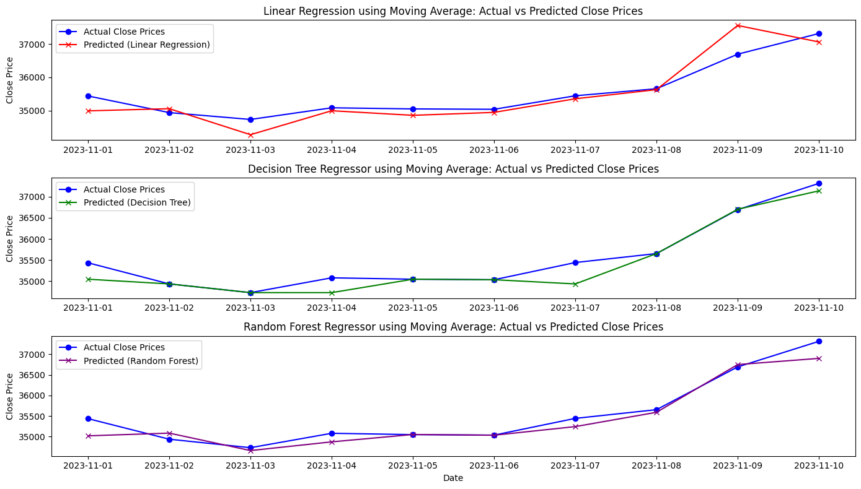
…

Slide 33
Key Insights and Conclusions from Regression Model Analysis
Performance Consistency Across Models
Consistent patterns in both scenarios (with and without Moving Average).
Indicates stable data characteristics across different models.
Impact of Moving Average
Linear Regression: Slight performance decrease with Moving Average.
Decision Tree & Random Forest: Noticeable performance decrease with Moving Average.
Best Overall Performer
Linear Regression shows the lowest MSE and highest R² consistently.
Suggests superior efficiency and accuracy for the given dataset.

Slide 34
Key Insights and Conclusions from Regression Model Analysis
Complexity vs. Performance Trade-off
Higher complexity in Decision Tree and Random Forest does not yield proportional performance improvement.
Highlights the importance of balancing model complexity and performance.
Model Selection Considerations
Linear Regression is preferred for minimizing MSE and maximizing R².
Other factors like interpretability and handling of non-linear relationships may influence model choice.
Risk of Overfitting
Exceptionally high R² values suggest potential overfitting, especially in complex models.
Recommends further investigation with cross-validation or separate test data.

Slide 35
Key Insights and Conclusions from Regression Model Analysis
Applicability for Future Predictions
High performance indicates reliability for future predictions.
Emphasizes the need for ongoing performance monitoring.

Slide 36
References
https://www.researchgate.net/publication/373014259_Stock_Price_Prediction_Website_Using_Linear_Regression_-_A_Machine_Learning_Algorithm
https://eudl.eu/pdf/10.4108/eai.18-11-2022.2327160

Slide 37
Github Link
https://github.com/saikirito09/CS661FinalProject

Slide 38
Thank You

